Slide 1
From Convenience to Sustainability
Moonsoo Kim
Spring 2023
Audience: Retailers and Policymakers in the Retail Industry

Slide 2
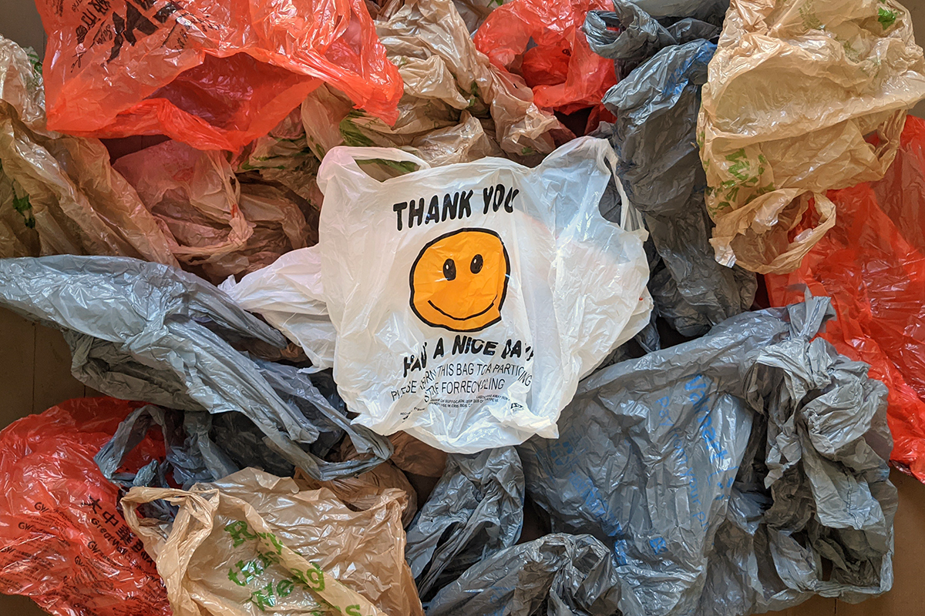
Once upon a time…
People used single-use plastic bags as a default option because they were easy to get and convenient.
Billions of these bags were used every year, which contributed to the growing global plastic waste problem.

Slide 3
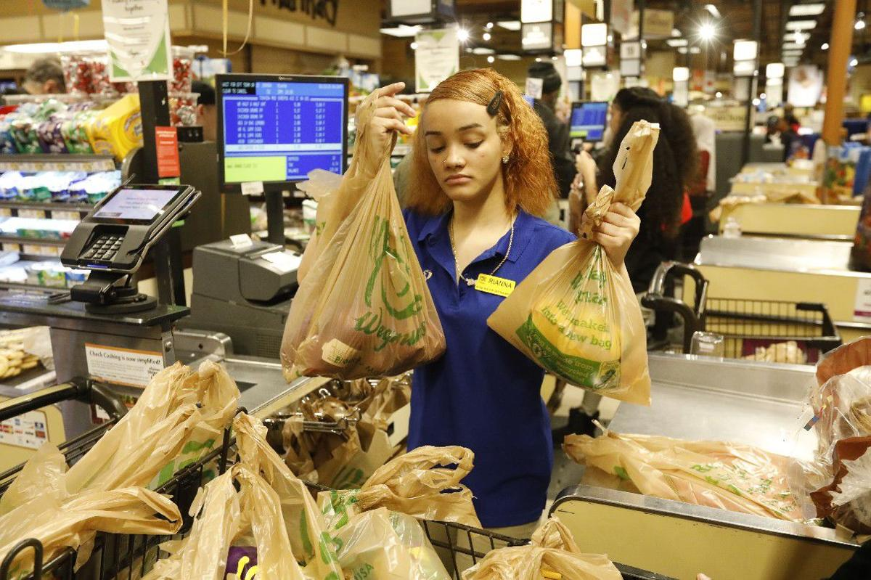
And every day…
Retailers gave out plastic bags for free, which made it easy for people to use them.
Consumers often did not realize or did not prioritize the impact of plastic bags on the environment.

Slide 4
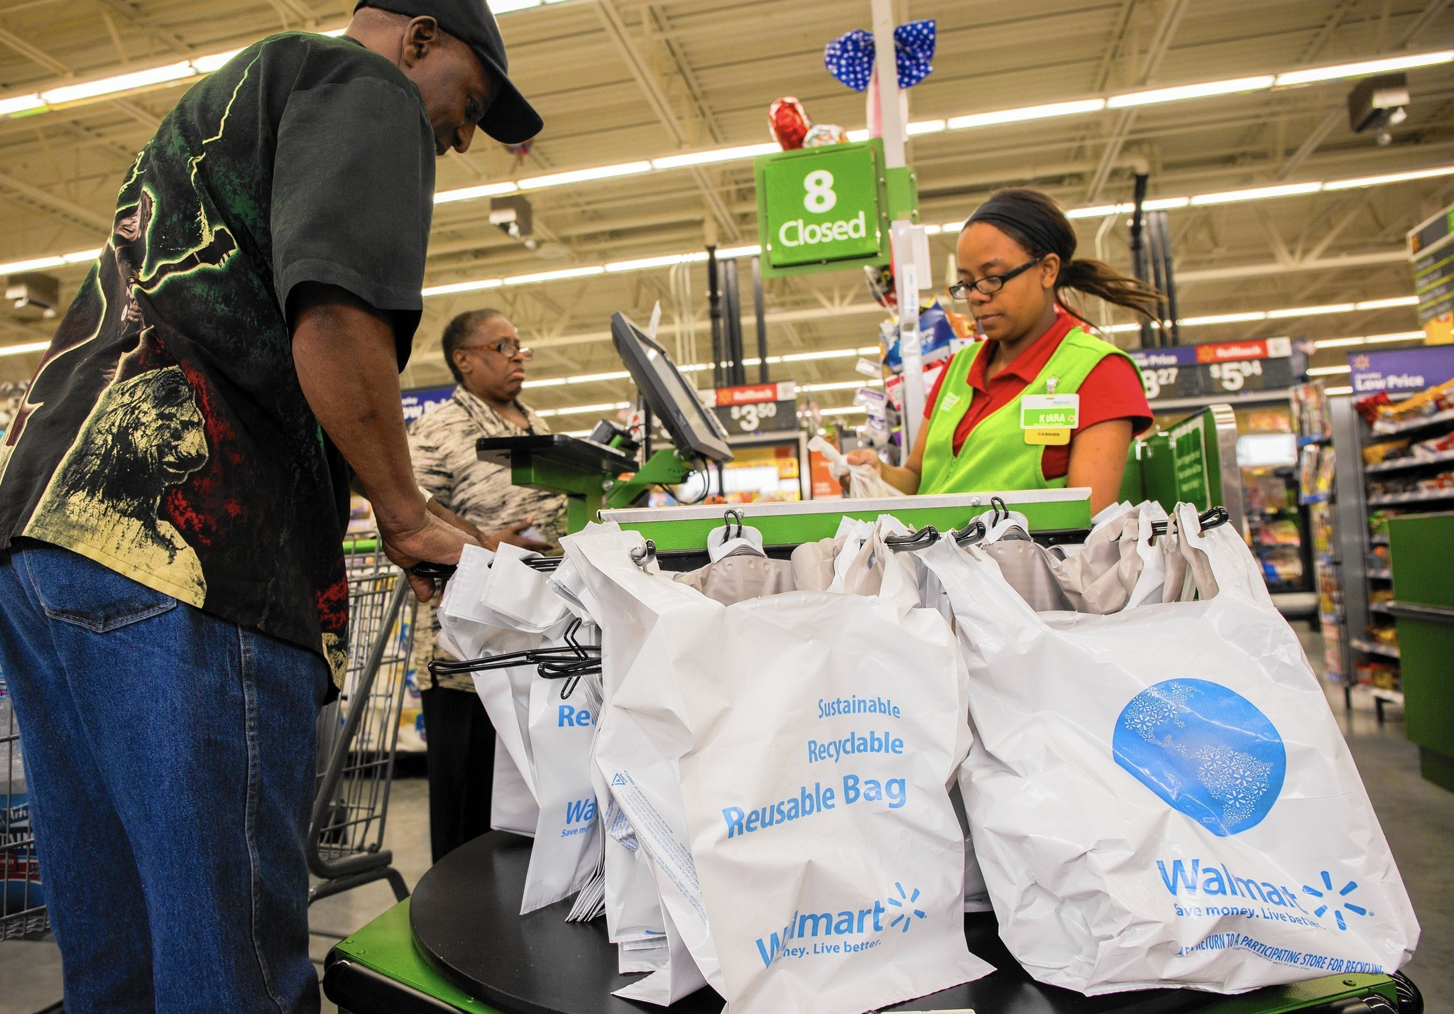
Until one day…
People started to become more aware of the environmental damage caused by plastic bags.
Governments took action by implementing bag bans, fees, or taxes on plastic bags.
Retailers started to offer alternative options such as reusable bags made of fabric or other materials.

Slide 5
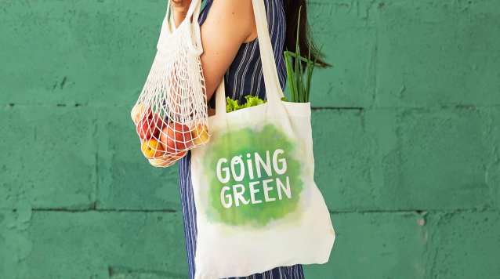
And because of this…
People had to change their habits by bringing their own bags or choosing alternative options.
The demand for single-use plastic bags decreased, which resulted in less plastic waste in landfills and oceans.

Slide 6
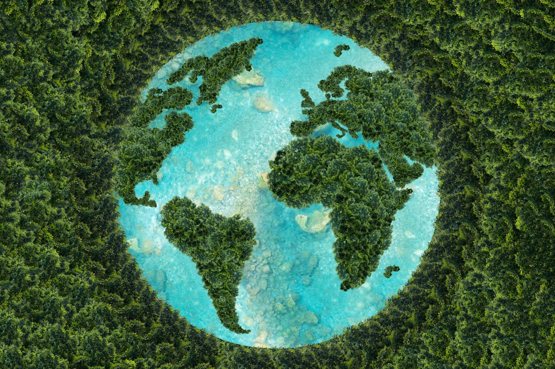
And because of this…
Reduction in litter and waste management costs: Cities and countries that have implemented plastic bag bans have seen a reduction in litter and waste management costs.
New business opportunities: Retailers have found new opportunities to offer sustainable alternatives and meet the growing demand from consumers for more environmentally friendly products.

Slide 7
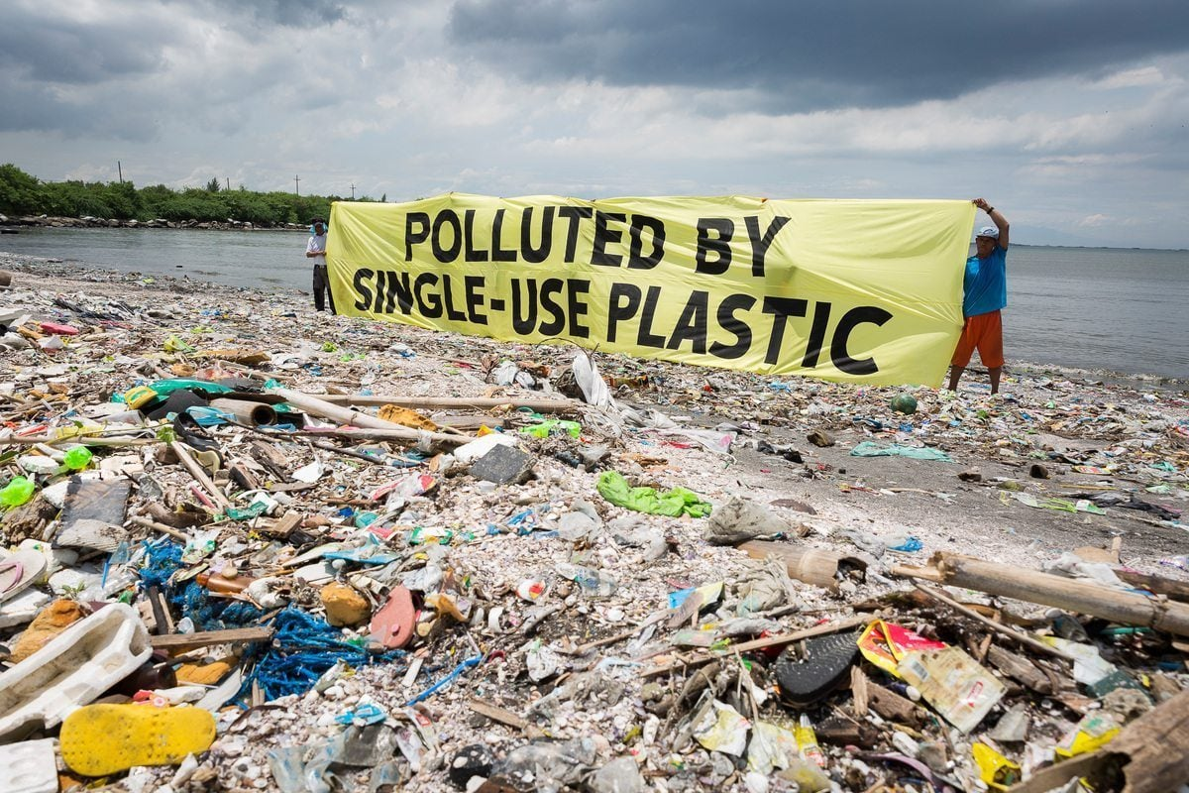
Until finally…
The use of single-use plastic bags decreased significantly, which led to less plastic waste in landfills and oceans.
Retailers found alternative, more sustainable options for carrying goods.
People became more aware of their impact on the environment and took steps to reduce their own waste.

Slide 8
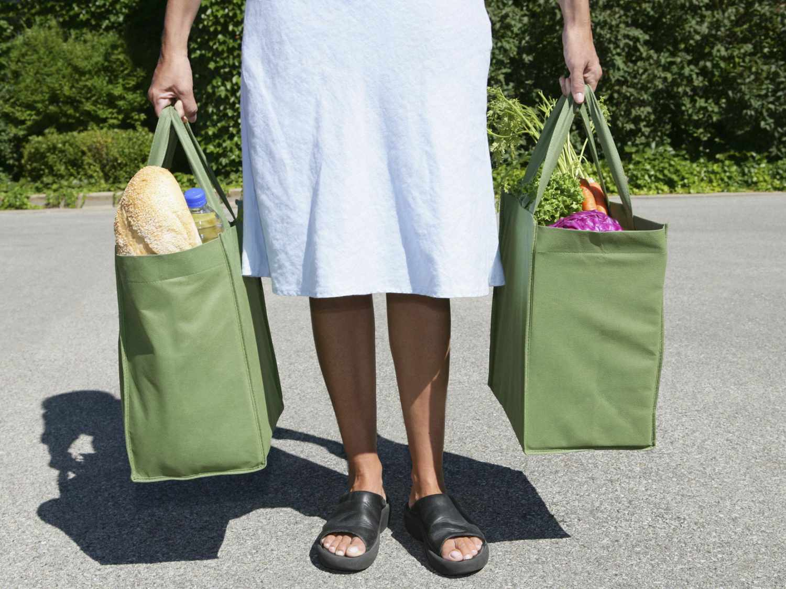
And ever since that day…
The world has continued to make progress in reducing the use of single-use plastic bags.
Many countries have successfully implemented bag bans.
Retailers have found innovative ways to provide sustainable options.
People have become more conscious of their environmental impact and have embraced more sustainable practices.

Slide 9
Sources
Articles:
(2019, July 24). Ever more countries are banning plastic bags. The Economist. https://www.economist.com/graphic-detail/2019/07/24/ever-more-countries-are-banning-plastic-bags?utm_medium=cpc.adword.pd&utm_source=google&ppccampaignID=17210591673&ppcadID=&utm_campaign=a.22brand_pmax&utm_content=conversion.direct-response.anonymous&gclid=CjwKCAjw5dqgBhBNEiwA7PryaCTTmfJJt14al4kHv-kUgJWb9aIX79MLoxG2UPZ4kBpOYYG9WaEFfhoCvwQQAvD_BwE&gclsrc=aw.ds
(2012, October 8). Should Cities Ban Plastic Bags? The WSJ. https://www.wsj.com/articles/SB10000872396390444165804578006832478712400https://www.wsj.com/articles/SB10000872396390444165804578006832478712400
Images:
https://www.ruralsprout.com/reuse-plastic-bags/
https://buffalonews.com/business/local/10-things-you-need-to-know-about-the-plastic-bag-ban/article_d34f3c37-2e6f-5f0b-b4f0-90d61332aa8f.html
https://www.chicagotribune.com/business/ct-plastic-bag-ban-0622-biz-20150622-story.html
https://www.timeforkids.com/partner/pwc/g56/april-2020-feature/
https://www.rd.com/article/most-sustainable-countries/
https://www.greenpeace.org/usa/oceans/preventing-plastic-pollution/
https://www.treehugger.com/paper-plastic-or-something-better-1204155

